Slide 2
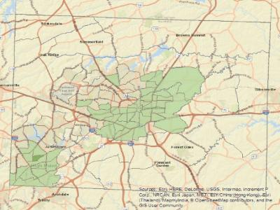
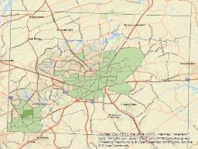
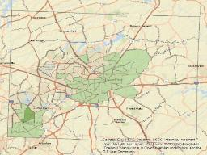
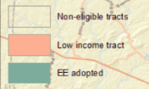
E-education (EE) program
Notes:
Suppose you need to map the predicted progress of a non-profit program that is bringing computers into schools in low-income census tracts in Guilford County Georgia.

Slide 3
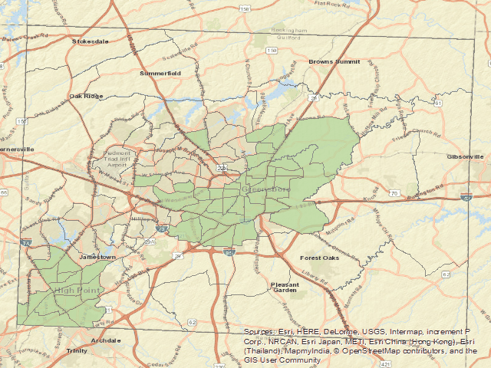
Notes:
The program will be introduced one tract at a time and grow to neighboring tracts from a starting tract. You need to build an animation like this.

Slide 4


Census tract polygons
Table of tract average income
Lat/long of first school computer program
Notes:
You have the census tract boundaries, a table of income level, and you know the location where the education program will start.

Slide 5


Census tract polygons
Table of tract average income
Lat/long of first school computer program
Add empty income level field to the tracts data (AddField)
Join the income level with the tracts polygons (MakeTableView, CopyRows, JoinField)
Iteratively find the next nearest low-income tract (SelectLayerByAttribute, Near)
Notes:
You know yo'll need to combine the polygons with the tabular data, so you figure yo'll need to add a field and then do a join. The tools yo'll need to call for this are AddField, MakeTableView, CopyRows, and JoinField. Then you need to find the nearest tract that's not yet in the program and keep doing this until all eligible tracts are in the program. For this yo'll need to call the SelectLayerByAttribute and Near tools.

Slide 6
Census tract polygons
Table of tract average income
Lat/long of first school computer program
Add empty income level field to the tracts data (AddField)
Join the income level with the tracts polygons (MakeTableView, CopyRows, JoinField)
Iteratively find the next nearest low-income tract (SelectLayerByAttribute, Near)
Make a tool for doing this in any county in other states.
Notes:
Then you realize the advocates of the E-education initiative would like to introduce the program in North and South Carolina as well, and yo'll need to reproduce this process for whichever counties they select. If you weren't already motivated to write a script for this before, now you really are! So how can you run tools from Python? And how much of this can you do from a Python script? You can do all of it. In upcoming videos we'll discuss the capabilities of arcpy and we'll get into the details of writing code to call tools.

Slide 8

Calling tools with arcpy
Python capabilities in ArcGIS
Environments settings
Calling tools
Online help
Spatial analyst
Dr. Tateosian

Slide 9
Calling tools with arcpy
Python capabilities in ArcGIS
Environments settings
Calling tools
Online help
Spatial analyst
Dr. Tateosian

Slide 10

Code and GIS
Notes:
Before we dig into calling tools, it's helpful to step back and reflect on the overall context of computer programming and GIS and then zoom in to coding and arcgis and then zoom in again to arcpy – since we call tools with arcpy.

Slide 11



Python and GIS

Slide 12
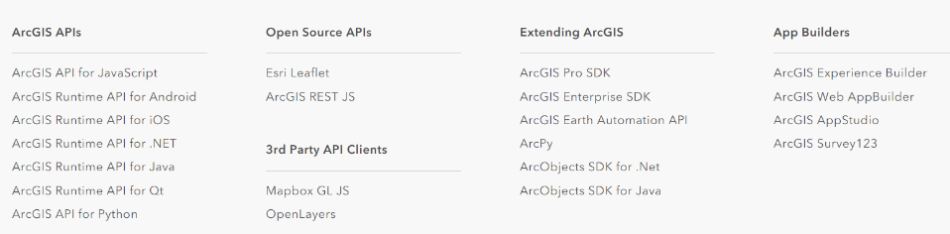




Programming and ArcGIS
arcpy
Notes:
An application programming interface (API) allows you to hook into the functionality of a program. ArcGIS various API's in various programming languages that are hooked into different parts of their software. For example, there is a ArcGIS API for JavaScript for creating interactive three-dimensional web applications. And there is the ArcGIS API for Python for managing ArcGIS Online data. This is not the same as arcpy, which is the focus in this course.

Slide 13
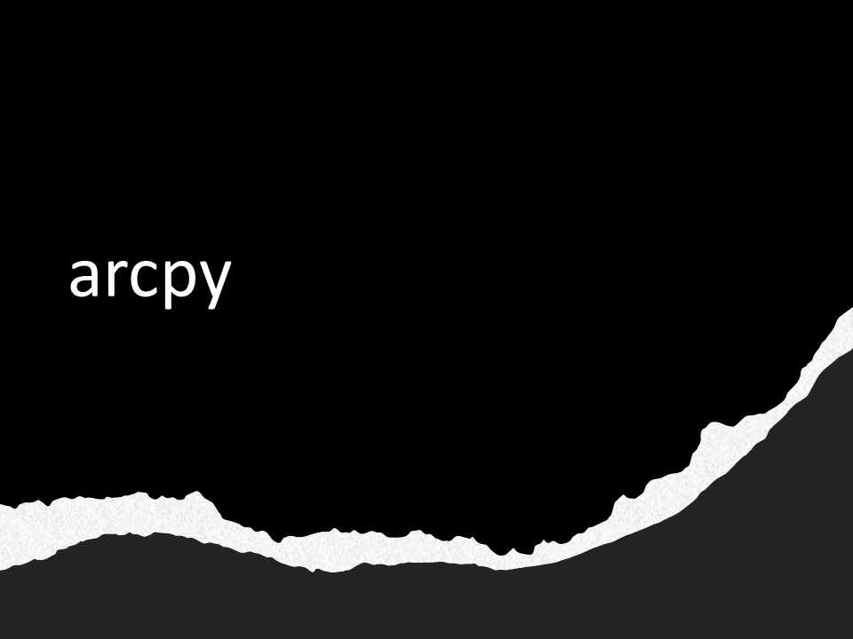
arcpy
Notes:
arcpy is the ArcGIS Python application programming interface (API) for the desktop applications (ArcGIS Desktop and ArcGIS Pro)
To use it, import arcpy.
Not a standard Python module (no ArcGIS == no arcpy). Examples of standard Python modules: os, math, sys, traceback, etc. These are always installed whenever Python is installed.

Slide 14
What can arcpy do?
Topic | Description | Code sample
Environment variables | Control geospatial analysis ambient settings | arcpy.env.workspace = 'C:/myDataDir'
Tools | Call ArcGIS Toolbox tools to invoke geospatial analyses | arcpy.analysis.Buffer(input,output,dist)
Describe | Explore GIS data properties (data type, format, etc.) | >>> dsc = arcpy.Describe('APHIS_GDELT12') >>> print(dsc.datatype) 'FeatureLayer'
List data | Get lists of specific types of GIS within a workspace | >>> arcpy.ListFeatureClasses() ['APHIS.shp', 'GDELT.shp', …]
Cursors | Read and modify GIS attribute tables | arcpy.da.SearchCursor(myGISdata, fieldNames)
Mapping | Manipulate existing maps, add layers to maps, modify surrounds, manipulate symbology, export screenshots | p = arcpy.mp.ArcGISProject("CURRENT") m = p.listMaps("Yosemite National Park")[0]
Other functions | Licensing, data management, messaging, etc. | arcpy.CheckOutExtension('Spatial') arcpy.GetMessages()
Notes:
Consider the things you can do by clicking around within the ArcGIS program. arcpy's functionality spans most of these capabilities. This table shows some examples that range from setting environment variables, to describing data, to mapping. By the end of these course, you will be proficient in all of these capabilities.

Slide 15
arcpy cheatsheet
describe data objects
cursors (data access)
҈ Describe
† baseName † dataType
† extension
Ӝ arcpy.da
← SearchCursor(data, fields, {where}, …)
← UdpdateCursor(data, fields, {where}…)
← InsertCursor(data, fields)
Ӝ arcpy
messaging ← AddMessage(message) ← GetMessages( )
licensing
← CheckOutExtension(ext. code)
describing data
← Describe(data)
Create objects
← Array
← Point ← Polyline ← Polygon
← ValueTable
parameters ← GetParameterAsText(index)
← SetParameterAsText(index, arg)
lists
← ListFields(dataset,{wild_card}, {field_type}) ← ListRasters({wild_card}, {geom_type})
tools
← analysis.Buffer(params…)
← sa.SquareRoot(params…)
exceptions
← ExecuteError
arcpy functions
҈ DataSet
† datasetType
† extent
҈ SearchCursor ←reset( )
҈ FeatureClass
† featureType
† shapeType
҈ UpdateCursor ←reset( )
←updateRow(row)
←deleteRow( )
҈ RasterDataset
† bandCount
† format
geometry tokens
SHAPE@
SHAPE@XY
SHAPE@AREA
҈ Workspace
† workspaceType
҈ InsertCursor
← insertRow(row)
҈ Array
҈ Field
† name
† type
҈ Geometry
҈ Result
† outputcount
← getOutput(index)
҈ Point
҈ Polyline
҈ Polygon
҈ SpatialReference(item)
҈ ValueTable ←AddRow
ӜӜ arcpy.mp arcpy.mp
҈ Layer
‡ visible
‡ name
҈ ArcGISProject ← listMaps(map, …)
҈ Map ← addDataFromPath(data_path) ← defaultview.exportToPNG(pic, w, h, …)
other
objects
mapping
cheatsheet key
† Read only property
‡ Read/write property
← Method
҈ Class
Ӝ Package or module
environment settings
҈ arcpy.env
‡ overwriteOutput
‡ workspace
Notes:
There is a lot to learn. This "cheatsheet" is designed to help you build a mental map of the arcpy functionality. It has a few notes about each of the parts that we will cover in this course. There's no way everything would fit on one sheet, so this only attempts to provide a few cues about each topic. Make a printout from the version linked to the course and then keep it handy as we work through the various boxes on this sheet. We'll step through how this page is organized, but since arcpy is object oriented, we first need to refresh some OOP concepts.

Slide 16
OOP & dot notation
Everything in Python is an object.
Object-oriented programming (OOP): code revolves around objects
Objects can have methods and properties associated with them.
Object: an instance of a data type
var = "Hello" # var is a string object
Method: a set of code associated with an object that performs some action related to its object. var.replace("l", "p") # replace is a string method
Property: variable associated with an object
arcpy.env.workspace = 'C/:Temp'
arcpy.env.overwriteOutput = True
# workspace and overwriteOutput
# are arcpy.env properties.

Slide 17
Practice with objects you know already
Write Python code to create objects as described here:
Create a float object named 'x' with a value of 5.
x = 5.0
Create a string object named 'fileName', giving it a value of 'park.shp'
fileName = 'park.shp'
Create a list object named 'mylist' that contains the integer objects 1, 2, and 3.
mylist = [1, 2, 3]
4. Call a list method to reverse the order of 'mylist'.
mylist.reverse()
Notes:
Select the *best* code statement for creating

Slide 18
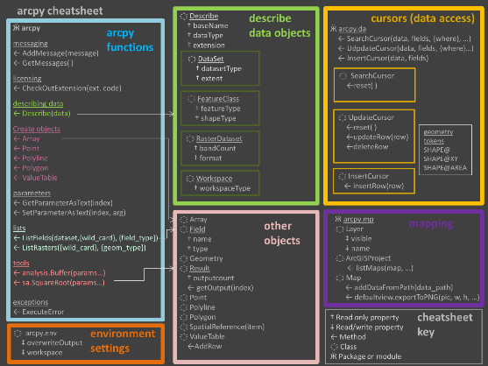
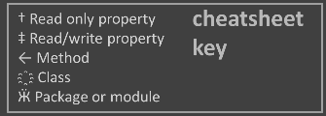
arcpy overview
Functionality is grouped
Environment settings
arcpy functions
Describe objects
Enumeration objects
Cursor objects
Other objects
Mapping
Describe
Cursors
arcpy
methods
Enumerations
Other
Objects
Mapping
Need to import arcpy to access these properties & methods.
Notes:
The items listed in the sheet are primarily properties and methods. These are variables and functions associated with arcpy and the objects defined within arcpy. The plus symbols indicate properties and the arrow symbols indicate methods. The functionality is grouped in boxes on this sheet. Let's step through just to provide a feel for you can do.
Environment settings allow you to set the project environment properties.
arcpy methods allow you to get messages about processes, create objects, and run toolbox tools, and amongst other things.
Describe objects allow you to get information about the datasets yo're dealing with, such as what shapetype your feature class has or what the name of the OID field is.
Enumerations objects allow you to perform batch processing. They return objects which contain lists of FeatureClasses, or Fields, or Datasets, and so forth.
Cursor objects allow you to process individual records in the data.
Other objects can be created. They will have the properties and/or methods specified in the pink box depending on which type of object they are.
And finally, the mp module enables you to work with projects and maps.

Slide 19
arcpy cheatsheet
describe data objects
cursors (data access)
҈ Describe
† baseName † dataType
† extension
Ӝ arcpy.da
← SearchCursor(data, fields, {where}, …)
← UdpdateCursor(data, fields, {where}…)
← InsertCursor(data, fields)
Ӝ arcpy
messaging ← AddMessage(message) ← GetMessages( )
licensing
← CheckOutExtension(ext. code)
describing data
← Describe(data)
Create objects
← Array
← Point ← Polyline ← Polygon
← ValueTable
parameters ← GetParameterAsText(index)
← SetParameterAsText(index, arg)
lists
← ListFields(dataset,{wild_card}, {field_type}) ← ListRasters({wild_card}, {geom_type})
tools
← analysis.Buffer(params…)
← sa.SquareRoot(params…)
exceptions
← ExecuteError
arcpy functions
҈ DataSet
† datasetType
† extent
҈ SearchCursor ←reset( )
҈ FeatureClass
† featureType
† shapeType
҈ UpdateCursor ←reset( )
←updateRow(row)
←deleteRow( )
҈ RasterDataset
† bandCount
† format
geometry tokens
SHAPE@
SHAPE@XY
SHAPE@AREA
҈ Workspace
† workspaceType
҈ InsertCursor
← insertRow(row)
҈ Array
҈ Field
† name
† type
҈ Geometry
҈ Result
† outputcount
← getOutput(index)
҈ Point
҈ Polyline
҈ Polygon
҈ SpatialReference(item)
҈ ValueTable ←AddRow
ӜӜ arcpy.mp arcpy.mp
҈ Layer
‡ visible
‡ name
҈ ArcGISProject ← listMaps(map, …)
҈ Map ← addDataFromPath(data_path) ← defaultview.exportToPNG(pic, w, h, …)
other
objects
mapping
cheatsheet key
† Read only property
‡ Read/write property
← Method
҈ Class
Ӝ Package or module
environment settings
҈ arcpy.env
‡ overwriteOutput
‡ workspace
Notes:
Again, there is a lot to learn. But remember, we'll be looking through this functionality over many weeks and then after all that work, yo'll be able to harness the functionality of ArcGIS in a very powerful way.

Slide 21
Geospatial Analysis
import arcpy
tbxs = arcpy.ListToolboxes()
len(tbxs)
> 40
tools = arcpy.ListTools()
len(tools)
> 1654
Notes:
You may be wondering what types of geoprocessing is possible in Python? ArcGIS has over 1500 tools.

Slide 22
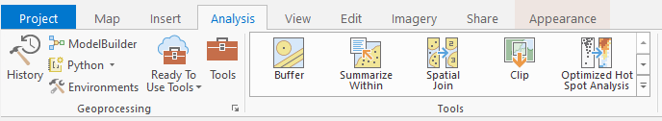
Geospatial Analysis
import arcpy
tbxs = arcpy.ListToolboxes()
len(tbxs)
> 40
tools = arcpy.ListTools()
len(tools)
> 1654
Analysis tab
Notes:
If you go to the analysis tab and click on Tools,

Slide 23
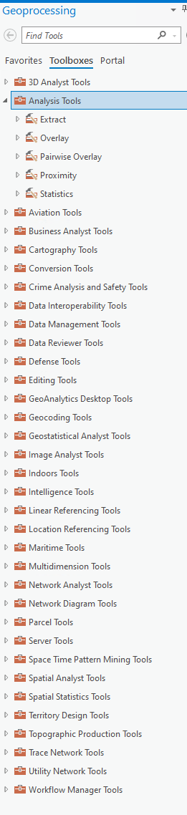
Geospatial Analysis
import arcpy
tbxs = arcpy.ListToolboxes()
len(tbxs)
> 40
tools = arcpy.ListTools()
len(tools)
> 1654
Analysis tab
Notes:
yo'll see a list of toolboxes. You click on any toolbox to expand the toolsets inside. You may not have the license for some of these. But if you can run it by hand, you can run it from Python.

Slide 24
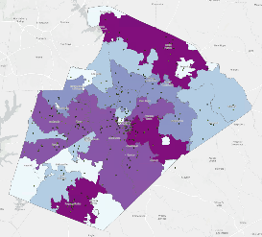
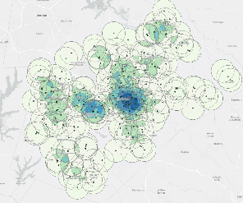
Proximity / Overlay
Analysis toolbox
Tools for extraction, proximity, and overlay analysis
Clip, Intersect, Union, Spatial Join, Near, Thiessen Polygons, Summarize Nearby, Summary Statistics,…
Summarize Within
Count Overlapping Features
Notes:
Some of the most commonly used tools pertain to proximity and overlay. These tools answer questions such as what is nearby or close to each other, what things are contained within other things, and where do things overlap. On the left, the summarize within tool was used to map the park counts within Wake County zip codes. On the right the count overlapping features was used to map show where 2-mile buffers around schools overlap.

Slide 25
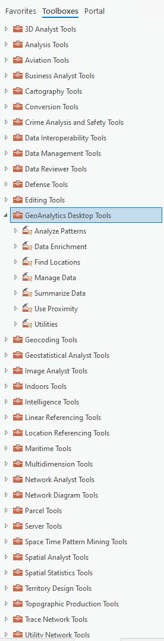

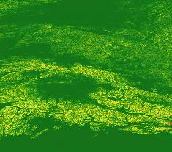
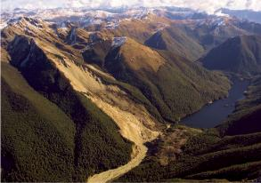
Raster Analysis
Spatial Analyst toolbox
Need SA extension
Spatial modeling and analysis tools for raster data
Density, Distance, Interpolation, Hydrology, Map Algebra,…
Elevation, slope, solar radiation, watershed deliniation
Notes:
Raster analysis is also used for many natural resources applications. For example, it could be used on rasters of mountainous regions along with earthquake data to identify lakes that are susceptible to landslides.

Slide 26
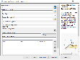

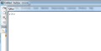
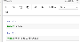
Ways to Perform Geospatial Analysis
Tool GUI
Python command
line in ArcGIS Pro
Modelbuilder
models
(1)
(2)
(7)
Export models to scripts
(3)
(6)
Call scripts from models
(4)
Python script
toolbox (contains GIS analysis tools)
(5)
Python Notebook
Notes:
There are multiple ways to conduct geospatial analysis with Python and ArcGIS.

Slide 28
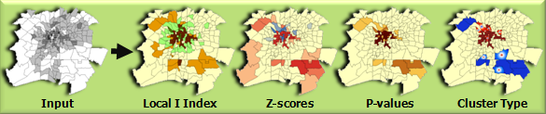
Help

Slide 29
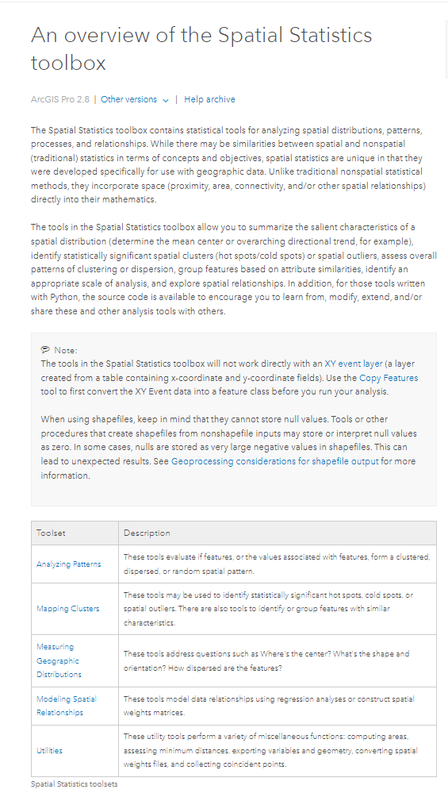
Help
arcpy Spatial Statistics

Slide 30
Help
arcpy Spatial Statistics

Slide 31
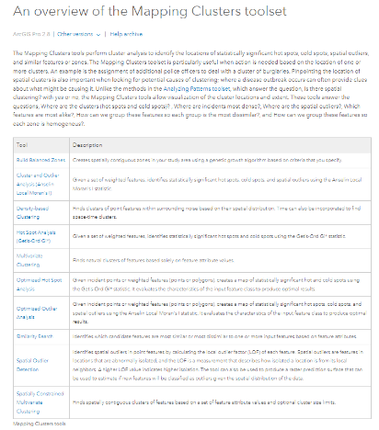
Help
arcpy Spatial Statistics

Slide 32
Help
arcpy Spatial Statistics

Slide 33
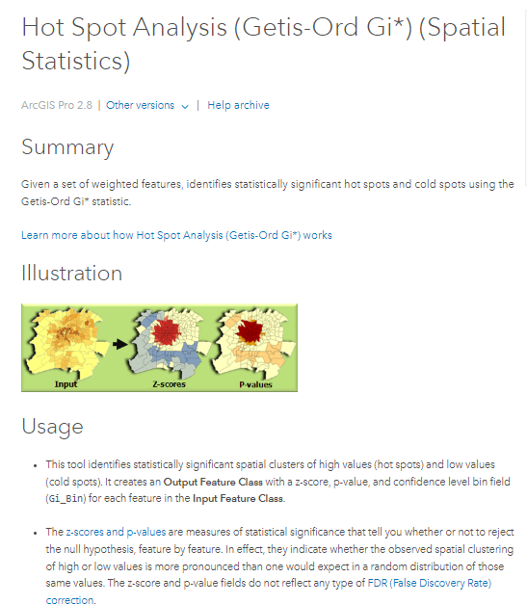

Slide 35
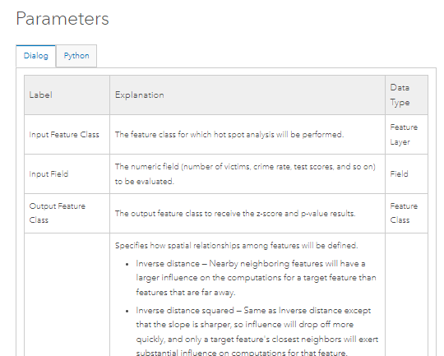
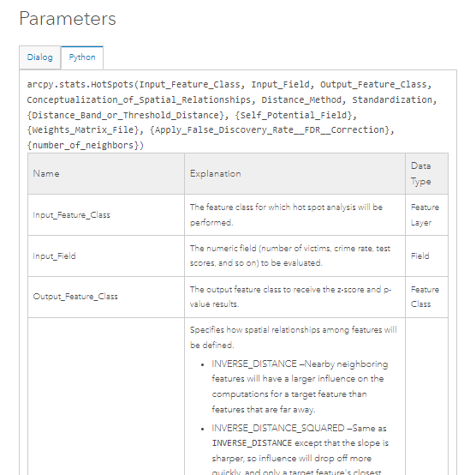

Slide 37
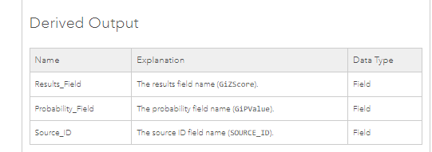

Slide 38
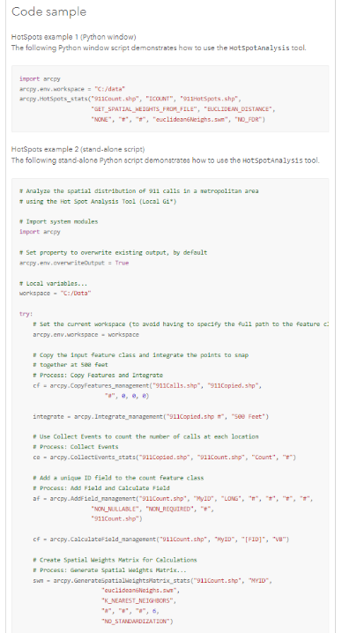

Slide 39
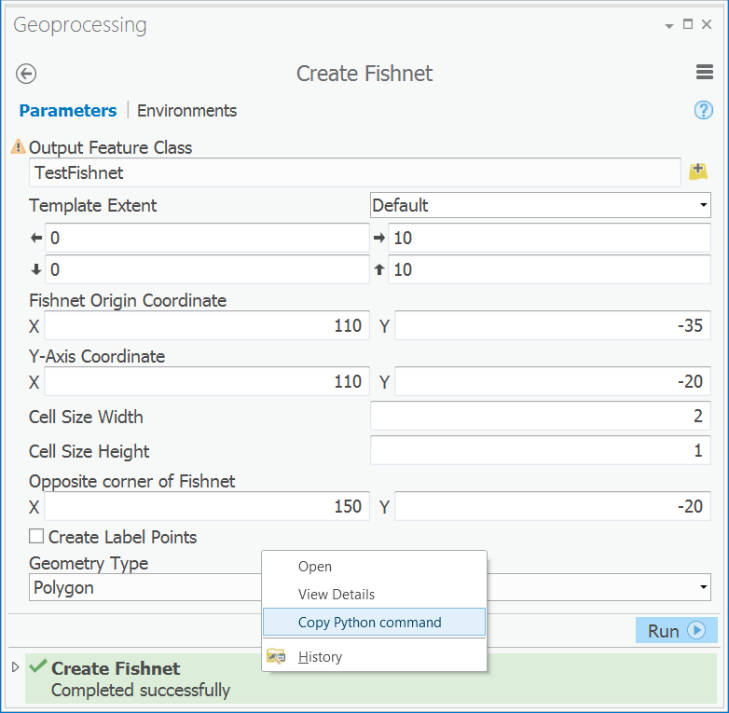
Copy code snippet
Run a tool from the geoprocessing pane
Right click on the successful run at the bottom (in green)
Choose "Copy Python command".
Paste the snippet into your code.

Slide 40
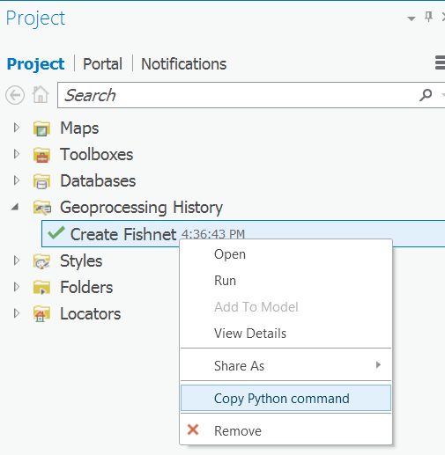
(or) Copy code snippet
ANALYSIS | History to open the Project pane's Geoprocessing History
Right-click the successful.
Choose "Copy Python command".
Paste the snippet into your code.

Slide 41
Community message boards
community.esri.com (ArcGIS Online)
https://gis.stackexchange.com/

Slide 43
Calling tools with arcpy

Slide 44
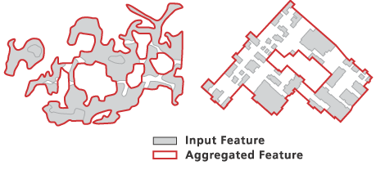
Aggregate polygons
Notes:
Suppose you want to aggregate the polygons that delineate marshes in the Everglades or you want to form one polygon from a group of buildings within a tiger preserve to plan for a barrier to be constructed around them. The aggregate polygons tool might be a good choice for this. Let's use that an example to study the syntax for calling tools in Python.

Slide 45
Syntax for calling tools
arcpy.cartography.AggregatePolygons(polyData, aggPolys,'2 km')
positional arguments
???
arcpy
object
Specifies
the toolbox alias.
tool method
argument
arcpy.toolboxAlias.ToolName(argument1, argument 2, …)
keyword arguments
Notes:
Python can call any tool in Toolbox for which you have the license.
Arguments specified in parentheses give the tool input.

Slide 46
Two formats
positional arguments
double-dot
arcpy.toolboxAlias.ToolName(argument1, argument 2, …)
underscore
arcpy.ToolName_toolboxAlias(argument1, argument 2, …)
keyword arguments
Notes:
Python can call any tool in Toolbox for which you have the license.
Arguments specified in parentheses give the tool input.

Slide 47
Underscore format
arcpy.AggregatePolygons_cartography(polyData, aggPolys,'2 km')
positional arguments
arcpy
object
Specifies
the toolbox.
tool method
argument
arcpy.ToolName_toolboxAlias(argument1, argument 2, …)
keyword arguments
Notes:
Python can call any tool in any Toolbox for which you have the license.
Arguments specified in parentheses give the tool input.
Positional arguments are ordered based on the function signature.
Keyword arguments use a keyword to indicate the parameter with which it belongs.
Unlike positional arguments, the ordering of keyword arguments does not matter. Instead of order, assignment statements are used to specify which options are being set; The option name goes on the left of the equals sign and the value on the right.

Slide 48
Two formats
positional arguments
double-dot
arcpy.ToolboxAlias.ToolName(argument1, argument 2, …)
underscore N/A for Spatial Analyst
arcpy.ToolName_toolboxAlias(argument1, argument 2, …)
keyword arguments
Notes:
Python can call any tool in Toolbox for which you have the license.
Arguments specified in parentheses give the tool input.

Slide 49
Toolbox Aliases
Toolbox name | Toolbox alias
Analysis Tools | analysis
Conversion Tools | conversion
Data Management Tools | management
Geocoding Tools | location
Spatial Analyst Tools | sa
3D Analyst Tools | 3d
… | …
For a complete list
print( arcpy.ListToolboxes() )
arcpy.analysis.Clip('PaCounty2021', 'APHIS_only12', "clipOutput.shp")
Analysis Tools
arcpy.management.Clip(myRast,theRectangle, outRast)
Data Management Tools
arcpy.Clip(inputData, someVar, outputData)
??? We don't know. AttributeError: module 'arcpy' has no attribute 'Clip'
Which toolbox is it in?
Notes:
Tool names must be unique within Toolboxes and must not have spaces or use other restricted characters such as percent symbols or slashes.
Tool names are UpperCamelCase.
Aliases are all lowercase.

Slide 50
Simple script calling a tool
import arcpy
arcpy.env.workspace = 'C:/gispy/data/ch06'
arcpy.cartography.AggregatePolygons('park.shp', 'aggpolys.shp', '2 km')
import arcpy
arcpy.env.workspace = 'C:/gispy/data/ch06'
outFileName = 'C:/gispy/scratch/aggpolys.shp',
arcpy.cartography.AggregatePolygons('park.shp', outFileName, '2 km')
Notes:
Python can call any tool in any of ArcGIS's Toolboxes (with one exception—Raster Calculator).
Arguments specified in parentheses give the tool input.

Slide 51
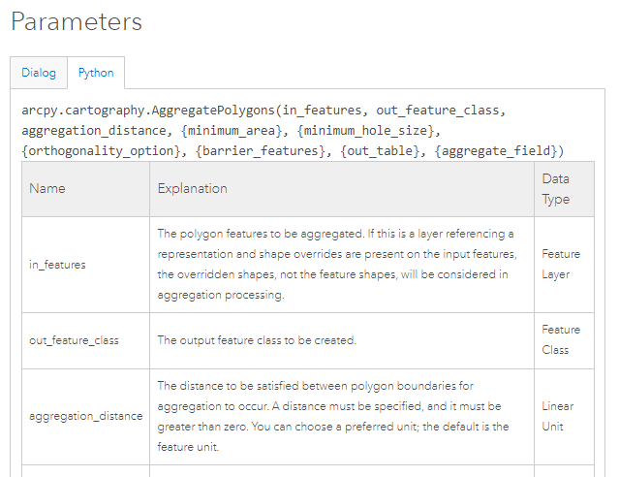
Positional Arguments
import arcpy
arcpy.env.workspace = 'C:/gispy/data/ch06'
arcpy.cartography.AggregatePolygons('park.shp', 'aggpolys.shp', '2 km’)
Notes:
Positional arguments are ordered based on the function signature.

Slide 52
Positional Arguments
import arcpy
arcpy.env.workspace = 'C:/gispy/data/ch06'
arcpy.cartography.AggregatePolygons('park.shp', 'aggpolys.shp', '2 km’,
'#', '50 meters')
Notes:
Arguments specified in parentheses give the tool input.

Slide 53
Keyword Arguments
import arcpy
arcpy.env.workspace = 'C:/gispy/data/ch06'
arcpy.cartography.AggregatePolygons(in_features='park.shp',
out_feature_class='aggpolys.shp',
aggregation_distance='2 km')
Notes:
Keyword arguments use sssignment statements are used to specify which options are being set;
The ordering of keyword arguments does not matter.
The option name goes on the left of the equals sign and the value on the right.

Slide 54
Keyword Arguments
import arcpy
arcpy.env.workspace = 'C:/gispy/data/ch06'
arcpy.cartography.AggregatePolygons(in_features='park.shp',
out_feature_class='aggpolys.shp',
aggregation_distance='2 km')

Slide 55
Equivalent tool calls
positional arguments
arcpy.cartography.AggregatePolygons(polyData, aggPolys,'2 km')
arcpy.cartography.AggregatePolygons(in_features = polyData,
out_feature_class = aggPolys,
aggregation_distance ='2 km')
arcpy.AggregatePolygons_cartography(polyData, aggPolys,'2 km')
keyword arguments
arcpy.AggregatePolygons_cartography(in_features = polyData,
out_feature_class = aggPolys,
aggregation_distance ='2 km')
Notes:
Python can call any tool in Toolbox for which you have the license.
Arguments specified in parentheses give the tool input.

Slide 56
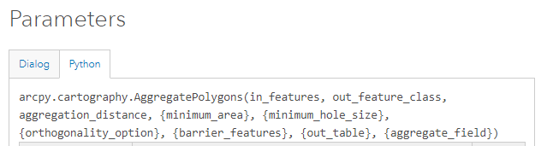
Code signature
arcpy.cartography.AggregatePolygons(polyData, aggPolys,'2 km')
arcpy.cartography.AggregatePolygons(in_features = polyData,
out_feature_class = aggPolys,
aggregation_distance ='2 km')

Slide 58
arcpy properties and methods

Slide 59
arcpy cheatsheet
describe data objects
cursors (data access)
҈ Describe
† baseName † dataType
† extension
Ӝ arcpy.da
← SearchCursor(data, fields, {where}, …)
← UdpdateCursor(data, fields, {where}…)
← InsertCursor(data, fields)
Ӝ arcpy
messaging ← AddMessage(message) ← GetMessages( )
licensing
← CheckOutExtension(ext. code)
describing data
← Describe(data)
Create objects
← Array
← Point ← Polyline ← Polygon
← ValueTable
parameters ← GetParameterAsText(index)
← SetParameterAsText(index, arg)
lists
← ListFields(dataset,{wild_card}, {field_type}) ← ListRasters({wild_card}, {geom_type})
tools
← analysis.Buffer(params…)
← sa.SquareRoot(params…)
exceptions
← ExecuteError
arcpy functions
҈ DataSet
† datasetType
† extent
҈ SearchCursor ←reset( )
҈ FeatureClass
† featureType
† shapeType
҈ UpdateCursor ←reset( )
←updateRow(row)
←deleteRow( )
҈ RasterDataset
† bandCount
† format
geometry tokens
SHAPE@
SHAPE@XY
SHAPE@AREA
҈ Workspace
† workspaceType
҈ InsertCursor
← insertRow(row)
҈ Array
҈ Field
† name
† type
҈ Geometry
҈ Result
† outputcount
← getOutput(index)
҈ Point
҈ Polyline
҈ Polygon
҈ SpatialReference(item)
҈ ValueTable ←AddRow
ӜӜ arcpy.mp arcpy.mp
҈ Layer
‡ visible
‡ name
҈ ArcGISProject ← listMaps(map, …)
҈ Map ← addDataFromPath(data_path) ← defaultview.exportToPNG(pic, w, h, …)
other
objects
mapping
cheatsheet key
† Read only property
‡ Read/write property
← Method
҈ Class
Ӝ Package or module
environment settings
҈ arcpy.env
‡ overwriteOutput
‡ workspace
Notes:
Again, there is a lot to learn. But remember, we'll be looking through this functionality over many weeks and then after all that work, yo'll be able to harness the functionality of ArcGIS in a very powerful way.

Slide 60
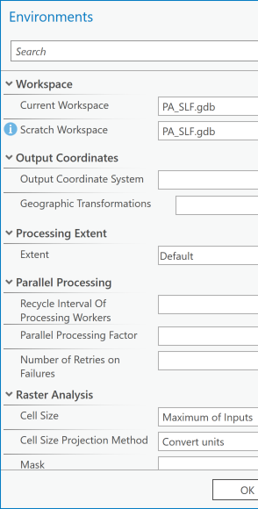
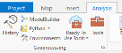
Environment Settings
Manual
ArcGIS Pro > Analysis Tab > Geoprocessing block > Environments
Python
All settings are arcpy.env properties
>>> arcpy.ListEnvironments()
['newPrecision', 'autoCommit', 'XYResolution', 'processingServerUser', 'XYDomain', 'processingServerPassword', 'scratchWorkspace', 'cartographicPartitions', 'terrainMemoryUsage', 'MTolerance', 'compression', 'coincidentPoints', 'randomGenerator', 'outputCoordinateSystem', 'rasterStatistics', 'ZDomain', 'cellSizeProjectionMethod', 'transferDomains', 'maintainAttachments', 'resamplingMethod', 'snapRaster', 'projectCompare', 'cartographicCoordinateSystem', 'configKeyword', 'outputZFlag', 'qualifiedFieldNames', 'tileSize', 'parallelProcessingFactor', 'pyramid', 'referenceScale', 'processingServer', 'extent', 'XYTolerance', 'tinSaveVersion', 'nodata', 'MDomain', 'spatialGrid1', 'cellSize', 'outputZValue', 'outputMFlag', 'geographicTransformations', 'spatialGrid2', 'ZResolution', 'mask', 'spatialGrid3', 'maintainSpatialIndex', 'workspace', 'MResolution', 'derivedPrecision', 'ZTolerance', 'scratchGDB', 'scratchFolder', 'packageWorkspace', 'addOutputsToMap', 'buildStatsAndRATForTempRaster']
Examples
arcpy.env.overwriteOutput = True
arcpy.env.workspace = 'C:/myDataDir'
Notes:
env is an arcpy class.
Setting overwriteOutput to True enables you to rerun scripts during development. Otherwise, an error will be thrown.
The workspaces specifies the default directory for the ArcGIS working environment. If full paths are not specified, Python will look for tool input data here and write output data here.

Slide 61
Dot notation & arcpy properties
arcpy.env.overwriteOutput = True
print(f'The workspace is {arcpy.env.workspace}.')
Properties don't use parentheses
Object.Property
Object.Property

Slide 62
Dot notation & arcpy methods
arcpy.Buffer_analysis('Freeways', 'FreewaysBuffer', 100)
arcpy.Exists('Freeways')
arcpy.CheckOutExtension('Network')
Parentheses around arguments Arguments separated by commas
Object.Method(arg1, ...)
Object.Method(arg1, ...)
Object.Method(arg1, ...)

Slide 64
Tools and the workspace
Notes:
When you call a tool, how does Python know where to look for the data? That's where the workspace comes into play. There are a few nuances you need to know about file names and workspaces.

Slide 65
Workspace & file names
env.workspace: specifies a default loc. for tool input/output
arcpy.env.workspace = 'C:/data.gdb'
arcpy.Buffer_analysis('pond', 'buff', '500 Feet')
arcpy.Buffer_analysis('C:/data.gdb/pond', 'C:/data.gdb/buff', '500 Feet')
For shapefiles, 'shp' extension required for input names.
>>> arcpy.env.workspace = 'C:/temp'
>>> arcpy.Buffer_analysis('park', 'buff', '1 mile')
ERROR: Input Features: Dataset C:/Temp/park does not exist …
>>> arcpy.Buffer_analysis ('park.shp', 'buff', '1 mile')
<Result 'C:\\Temp\\buff.shp'>
To place output in a different location, specify path.
arcpy.env.workspace = 'C:/dataDir'
arcpy.Buffer_analysis ('lake.shp', 'C:/buffers/lakeBuff.shp', '1 mile')
arcpy.Buffer_analysis ('lake.shp', '/out/lakeBuff.shp', '1 mi')
Only use base name
(workspace set)
Use full path (workspace not set)
absolute path
relative path
Notes:
We usually want to set the arcpy workspace before calling tools. This allows us to only specify the base name of the script.
arcpy operations use this as the default location to look for input and create output, unless otherwise specified.

Slide 66
Absolute vs. relative paths
An absolute file path specifies how to access a given file or directory, starting from the root of the file system.
A relative file path is interpreted from the perspective of your current workspace.
In a sense, whenever you use a relative file path, it is joined with your current workspace to create an absolute file path internally.
absolute path
arcpy.env.workspace = 'C:/dataDir'
arcpy.Buffer_analysis ('lake.shp', 'C:/buffers/lakeBuff.shp', '1 mile')
arcpy.Buffer_analysis ('lake.shp', '/out/lakeBuff.shp', '1 mi')
relative path
'/out/lakeBuff.shp' -> 'C:/dataDir/out/lakeBuff.shp'
Notes:
>>> import arcpy
>>> arcpy.Exists("C:/gispy/data/ch06/park.shp")
True
>>> arcpy.env.workspace
''
>>> arcpy.Exists("park.shp")
False
>>> arcpy.env.workspace = 'C:/gispy/data/ch06'
>>> arcpy.Exists("park.shp")
True
>>> arcpy.env.workspace = 'C:/gispy/'
>>> arcpy.Exists("park.shp")
False
>>> arcpy.Exists("data/ch06/park.shp")
True

Slide 67
Workspace and arcpy.Exists()
>>> import arcpy
>>> arcpy.Exists("C:/gispy/data/ch06/park.shp")
True
>>> arcpy.env.workspace
''
>>> arcpy.Exists("park.shp")
False
>>> arcpy.env.workspace = 'C:/gispy/data/ch06'
>>> arcpy.Exists("park.shp")
True
>>> arcpy.env.workspace = 'C:/gispy/'
>>> arcpy.Exists("park.shp")
False
>>> arcpy.Exists("data/ch06/park.shp")
True

Slide 68
Typical geoprocessing script flow
# 1. import arcpy & set environment, output directory
import arcpy
arcpy.env.workspace = 'C:/gispy/data/ch06/'
outputDir = 'C:/gispy/scratch/'
arcpy.env.overwriteOutput = True
# 2. Initialize parameters
inputRaster = 'getty_rast'
outputFile = outputDir + 'output.txt'
# 3. Call tool(s) using format
# object.toolboxAlias.ToolName(arguments)
arcpy.conversion.RasterToASCII(in_raster=inputRaster, out_ascii_file=outputFile)
Notes:
ASCII formatted files are a text representation of rasters. You want to convert an ESRI GRID raster to ASCII format so that you can run it through a model that requires ASCII formatted input.
You write the code for this using the typical flow for a geoprocessing script.
# 1 importing arcpy, setting environment variable, and setting a output directory.
# 2 initialize the parameters
# 3 Call the tool using the variables you have set up.
inputRaster is set to getty_rast. Since the absolute path of getty_rast is not set, arcpy will look for getty_rast in the workspace.

Slide 69


Why use variables?
import arcpy
arcpy.env.overwriteOutput = True arcpy.conversion.RasterToASCII('C:/gispy/data/ch06/getty_rast', 'C:/gispy/scratch/output.txt')
import arcpy
arcpy.env.workspace = 'C:/gispy/data/ch06/'
outputDir = 'C:/gispy/scratch/'
arcpy.env.overwriteOutput = True
inputRaster = 'getty_rast'
outputFile = outputDir + 'output.txt'
arcpy.conversion.RasterToASCII(in_raster=inputRaster, out_ascii_file=outputFile)

Slide 70
Typical geoprocessing script flow
# 1. import arcpy & set environment, output directory
import arcpy
arcpy.env.workspace = 'C:/gispy/data/ch06/'
outputDir = '../../scratch/'
arcpy.env.overwriteOutput = True
# 2. Initialize parameters
inputRaster = 'getty_rast'
outputFile = outputDir + 'output.txt'
# 3. Call tool(s) using format
# object.toolboxAlias.ToolName(arguments)
arcpy.conversion.RasterToASCII(in_raster=inputRaster, out_ascii_file=outputFile)

Slide 72
Tool parameters
Parameters help table
Distance parameters
Output to input parameters
Multi-part parameters
Expression parameters
Notes:
To call tools in Python, you need to understand the parameter help table. We'll talk about that now and then look at some special types and uses of parameters that you are likely to encounter.

Slide 73
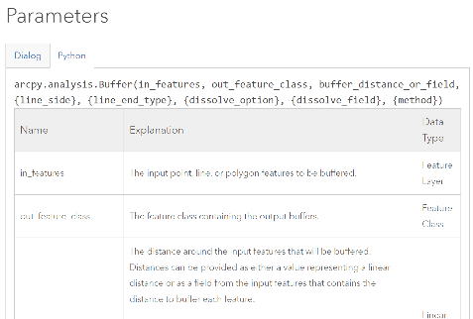
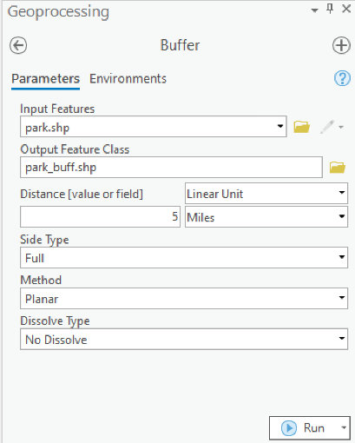
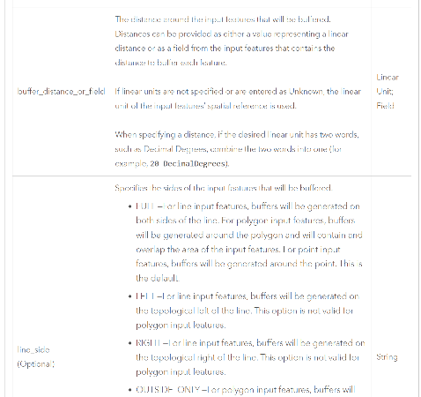
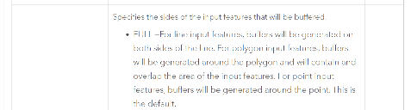
Buffer Tool User Interface
Buffer Parameter Table
Notes:
Since you are familiar with running tools through the geoprocessing panel, it's helpful to note the relationship between this dialog with boxes and buttons and the parameter table you see in the tool help. Each choice you make in the GUI corresponds to a parameter in the table. And each parameter in the table is a value you can specify in a Python tool call.

Slide 74
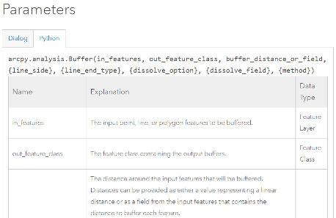
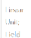
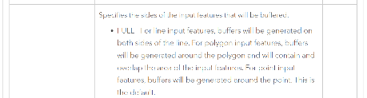
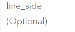
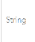
Parameters
signature: template for the Python code
Optional parameters shown with curly braces { } in template.
Positional Arguments must be in the order shown in signature
To use some, but not all, optional parameters, use '#' as a placeholder.
# Use default value for line_side, but set the value for line_end_type.
arcpy.Buffer_analysis ('lake.shp', 'buff.shp', '1 mile', '#', 'FLAT')
required
optional

Slide 75
Parameters
The Data Type column refers to ArcGIS data types (not Python data types).
Most parameters are specified in Python as Python strings.
arcpy.Buffer_analysis ('lake.shp', 'buff.shp', '1 mile', '#', 'FLAT')

Slide 76
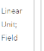
Distance parameters
A linear unit is an ArcGIS data type for Euclidean distances.

Slide 77
Linear units
Linear Units of Measure (not case sensitive):
centimeters | decimal degrees | decimeters | feet | inches | kilometers | meters | miles | millimeters | nautical miles | points | unknown | yards
Singular and plural both accepted (e.g., mile or miles).
arcpy.Buffer_analysis ('lake.shp', 'buff.shp', '1 kilometers')

Slide 78
Unit not specified?
If only a numeric value is specified and a distance unit is not specified (e.g., '5'), the tool uses the units of the input feature, unless the Output Coordinate System environment property has been set.
arcpy.Buffer_analysis ('lake.shp', 'buff.shp', '5000')

Slide 79

Notes:
For practice, writing tool calls, we'll look at a wildfire example.

Slide 80
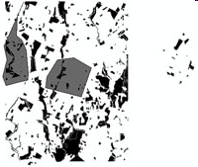
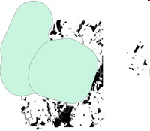
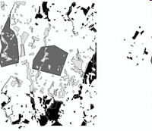
Wildfire Damage Assessment
Find the portion of a park which lies within 1 mile of the fire damage.
fire
1 mile fire buffer
(Clipped) Park region
close to fire
park.shp
special_regions.shp
special_regionsBuffer.shp
parkDamageBuffer.shp
Notes:
Suppose there was a park wildfire and you want to buffer the fire zone and clip that region of the park. These 3 images depict the process. The first shows the special regions dataset. Those are where the fire occurred. This is overlayed on the park dataset, the darker polygons in that image. The 2nd image shows the results of buffering the special region. The 3rd image shows the final output-- the park polygons within 1 mile of the fire in light gray.

Slide 81
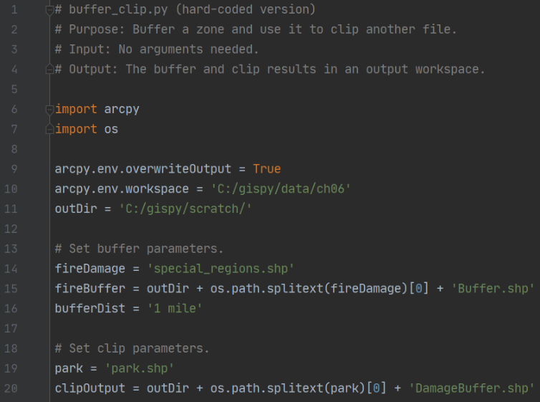
Wildfire Damage Assessment script
returns name with no extension
Add code to buffer the fireDamage by 1 mile.

Slide 82
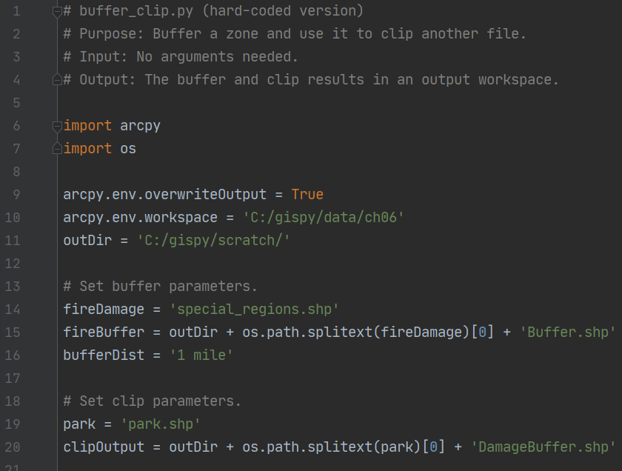
Wildfire Damage Assessment script
Add code to clip the park on the fireBuffer.

Slide 83
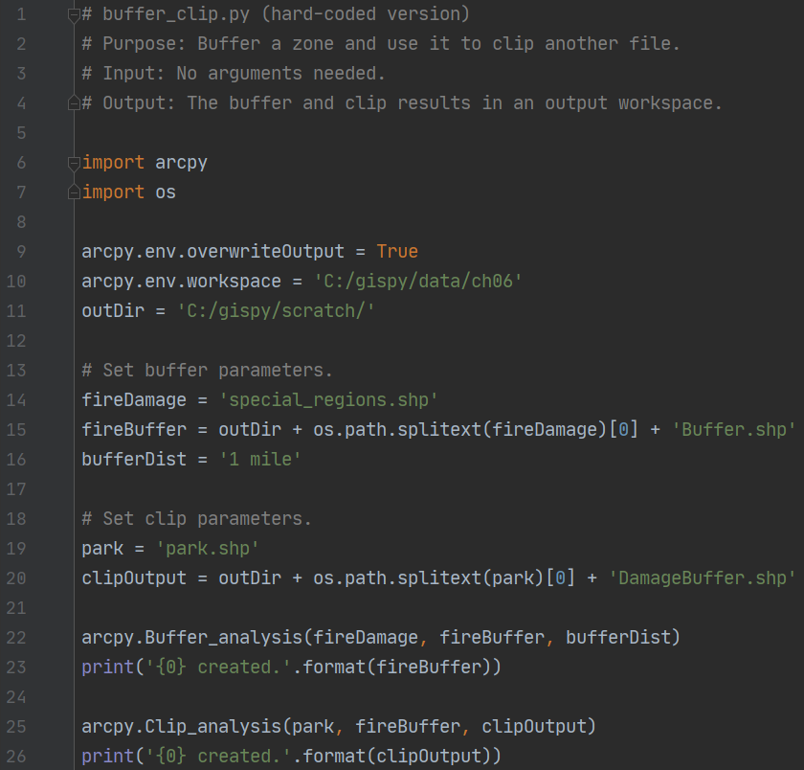
Wildfire Damage Assessment script
output buffer
clip feature
Notes:
Arcpy.analysis.Clip(

Slide 84

Multi-part parameters
Some tools accept multiple values as input for a single parameter.
Use a Python list.
inputFiles = ['park.shp', 'special_regions.shp', 'workzones.shp']
arcpy.management.Merge(inputFiles, 'mergedData.shp')

Slide 85

Expression parameters
The expression value will populate all (or selected) rows of a given field.
.data = 'C:/gispy/data/ch06/data1.shp'
fieldName = 'result’
numeric_expression = 5
arcpy.management.CalculateField(in_table=data,
field=fieldName,
expression = numeric_expression)

Slide 86
Expression parameters
Expressions can use other fields in the data.
coverage and measure are field names.
field_expression = '2*!measure! - !coverage!'
arcpy.management.CalculateField(in_table=data,
field=fieldName,
expression = field_expression)

Slide 87
Expression parameters
Expressions can use Python code blocks.
# Name: CalculateField_ranges.py
# Import system modules
import arcpy
# Set environment settings
arcpy.env.workspace = "C:/data/airport.gdb"
# Set local variables
inTable = "parcels"
fieldName = "areaclass"
expression = "getClass(float(!SHAPE.area!))"
codeblock = """
def getClass(area):
if area <= 1000:
return 1
if area > 1000 and area <= 10000:
return 2
else:
return 3"""
# Run AddField
arcpy.management.AddField(inTable, fieldName, "SHORT")
# Run CalculateField
arcpy.management.CalculateField(inTable, fieldName, expression, "PYTHON3", codeblock)

Slide 88
Expression parameters
Expressions can also use the Shape field.
The Shape field contains a Geometry object.
Geometry objects have properties such as 'area' and 'length’.
data = 'C:/special_regions.shp'
fieldName = 'PolyArea’
shape_expression = '!shape.area!'
arcpy.management.CalculateField(in_table=data,
field=fieldName,
expression = shape_expression)

Slide 89


Summary
Parameters
Help table
Distance
Output to input
Multi-part
Expression
Tools
double-dot | underscore
positional | keyword arguments
setting environment variables
object.method | object.property
setting the workspace
absolute | relative paths

Slide 91

Spatial Analyst Toolbox
Notes:
The spatial analyst toolbox contains a variety of tools for calculating spatial measures such as density, distance, and neighborhood properties as well as for computing map algebra.
The image was created by the Aspect tool. Aspect is the orientation of slope. The slope aspect is useful for agricultural applications, such as planning a vineyard.

Slide 92
3 Things about Spatial analyst
1 The alias is sa and underscore format is not available (ToolName_sa)
outputRast = arcpy.sa.SquareRoot(inRast)
2 Many sa tools return a Raster object. Call save to write the raster to disk.
outputRast.save('gettySqRoot’)
3 Raster object(s) remains in-memory until deleted.
del outputRast
Notes:
Taking the square root of the elevations data brings out details in low-lying areas that are commonly lost to the ruggedness of mountainous areas.

Slide 93

Compute value on each cell
import arcpy
arcpy.env.workspace = 'C:/gispy/data/ch06'
outDir = 'C:/gispy/scratch/'
arcpy.env.overwriteOutput = True
inRast = 'getty_rast'
outputRastName = outDir + 'gettySqRoot'
rastObject = arcpy.sa.SquareRoot(inRast)
rastObject.save(outputRastName)
del rastObject

Slide 94
Compute value on each cell
import arcpy
arcpy.env.workspace = 'C:/gispy/data/ch06'
outDir = 'C:/gispy/scratch/'
arcpy.env.overwriteOutput = True
inRast = 'getty_rast'
outputRastName = outDir + 'gettySqRoot'
rastObject = arcpy.sa.SquareRoot(inRast)
rastObject.save(outputRastName)
del rastObject

Slide 95
Compute value on each cell
import arcpy
arcpy.env.workspace = 'C:/gispy/data/ch06'
outDir = 'C:/gispy/scratch/'
arcpy.env.overwriteOutput = True
inRast = 'getty_rast'
outputRastName = outDir + 'gettySqRoot'
rastObject = arcpy.sa.SquareRoot(inRast)
rastObject.save(outputRastName)
del rastObject

Slide 96
Compute value on each cell
import arcpy
arcpy.env.workspace = 'C:/gispy/data/ch06'
outDir = 'C:/gispy/scratch/'
arcpy.env.overwriteOutput = True
inRast = 'getty_rast'
outputRastName = outDir + 'gettySqRoot'
rastObject = arcpy.sa.SquareRoot(inRast)
rastObject.save(outputRastName)
del rastObject

Slide 97
Importing spatial analyst
The ArcGIS Resources Spatial Analyst tool reference pages sometimes use a variation of the import statement in the code samples as in the following code:
>>> from arcpy.sa import * # Don't use this!
Creates a direct reference to the Spatial Analyst tool; provides a shortcut tools can be called without arcpy.sa.
Can replace this statement:
>>> outputRast = arcpy.sa.SquareRoot(inRast)
with the following:
>>> outputRast = SquareRoot(inRast)
Confusing code:
>>> outputRast = Int(inRast) # Raster operation
>>> outputNum = int(myNum) # Built-in function call
Avoids ambiguities.
>>> import arcpy # Use this!
>>> outputRast = arcpy.sa.SquareRoot(inRast)

Slide 98
sa raster calculator tool
Performs map algebra (operations on each cell).
arcpy.sa.RasterCalculator(a, b, sum)
Use sa math toolset instead
outRast1 = arcpy.sa.Times(5, 'getty_rast')
outRast2 = arcpy.sa.Minus(outRast1, 2)
outRast2.save('equationRast')
Or create Raster Object and use operators
rastObj = arcpy.Raster('getty_rast')
outRast = 5*rastObj – 2
outRast.save('equationRast2')

Slide 99
Compute value on each cell
import arcpy
arcpy.env.workspace = 'C:/gispy/scratch/alaska.gdb'
outDir = 'C:/gispy/scratch/'
arcpy.env.overwriteOutput = True
inRast = arcpy.Raster('elev')
outputRastName = outDir + 'exag'
arcpy.CheckOutExtension('Spatial')
rastObject = (2 * inRast) + 4
rastObject.save(outputRastName)
del rastObject

Slide 100

Summary
Spatial Analyst
check out the extension
save the raster result
delete the in-memory raster

Slide 102
Tool results

Slide 103
Tool Results
sa tools return Raster objects.
Others return Result objects.
arcpy.analysis.Buffer('C:/x.shp', 'C:/out.shp', '5’)
> 'C:/out.shp'

Slide 104
Tool Results
sa tools return Raster objects.
Others return Result objects.
arcpy.analysis.Buffer('C:/x.shp', 'C:/out.shp', '5’)
> 'C:/out.shp’
This is NOT a string

Slide 105

Tool Results

Slide 106

Example: Create a file GDB
Create a file geodatabase, wakeOutData.gdb.
Data management tool: CreateFileGDB

Slide 107
Tool Results from CreateFileGDB
Does CreateFileGDB return the gdb name?
>>> gdb_res_obj = arcpy.management.CreateFileGDB("C/gispy","wakeOutData.gdb")
>>> print(gdb_res_obj)
C:/gispy/wakeOutData.gdb
This is NOT return a string
gdb_res_obj.upper()
Traceback (most recent call last):
File "<string>", line 1, in <module>
AttributeError: 'Result' object has no attribute 'upper’
Use getOutput to get the string
>>> out_gdb = gdb_res_obj.getOutput(0)
>>> print(out_gdb)
C:\gispy\wakeOutData.gdb
>>> out_gdb.upper()
C:\GISPY\WAKEOUTDATA.GDB

Slide 108

arcpy Result object
҈ Result
† maxSeverity
† messageCount † outputCount
† resultID
† status
← cancel ()
← getInput (index)
← getMapImageURL ({param_list},…)
← getMessage (index)
← getMessages ({severity})
← getOutput (index)
← getSeverity (index)
ToolAlias.toolName(param1, param2, …): Result object

Slide 109
arcpy Result object
>>> pnResult = arcpy.analysis.PolygonNeighbors('parks.shp', 'PN.dbf ')
>>> type(pnResult)
'arcpy.arcobjects.arcobjects.Result'>
҈ Result
† maxSeverity
† messageCount † outputCount
† resultID
† status
← cancel ()
← getInput (index)
← getMapImageURL ({param_list},…)
← getMessage (index)
← getMessages ({severity})
← getOutput (index)
← getSeverity (index)
ToolAlias.toolName(param1, param2, …): Result object

Slide 110
arcpy Result object
>>> pnResult = arcpy.analysis.PolygonNeighbors('parks.shp', 'PN.dbf ')
>>> pnResult.outputCount
1
҈ Result
† maxSeverity
† messageCount † outputCount
† resultID
† status
← cancel ()
← getInput (index)
← getMapImageURL ({param_list},…)
← getMessage (index)
← getMessages ({severity})
← getOutput (index)
← getSeverity (index)
ToolAlias.toolName(param1, param2, …): Result object

Slide 111
arcpy Result object
>>> pnResult = arcpy.analysis.PolygonNeighbors('parks.shp', 'PN.dbf ')
>>> pnResult.getOutput(0)
'C:/Temp/PN.dbf'
҈ Result
† maxSeverity
† messageCount † outputCount
† resultID
† status
← cancel ()
← getInput (index)
← getMapImageURL ({param_list},…)
← getMessage (index)
← getMessages ({severity})
← getOutput (index)
← getSeverity (index)
ToolAlias.toolName(param1, param2, …): Result object

Slide 112
Printing the results
If there is only ONE part to the results, only need print to print the results.
>>> rc = arcpy.Buffer_analysis('C:/x.shp', 'C:/out.shp', '5')
>>> print rc
C:\\out.shp
If the result is multi-part only ONE of results is printed with a print statement.
>>> rc = arcpy.AverageNearestNeighbor_stats('C:/points.shp', 'Euclidean Distance')
>>> print rc
0.64632
Need to use outputCount and getOutput

Slide 113

Tool Results Example 2
Some tool return multi-part outputs.
rc = arcpy.AverageNearestNeighbor_stats(
'C:/points.shp',
'Euclidean Distance')
Check the outputCount property
>>> rc.outputCount
6
getOutput method and index number
>>> rc.getOutput(0)
'0.64632' # nearest neighbor index
>>> rc.getOutput(1)
'-4.27929' # z score
>>> rc.getOutput(2)
'0.000019' # p-value

Slide 114
Get all results with a loop
rc = arcpy.AverageNearestNeighbor_stats(
'C:/points.shp',
'Euclidean Distance')
for res_num in range(rc.outputCount):
print(rc.getOutput(res_num))
0.64632 # nearest neighbor index
-4.27929 # z score
0.000019 # p-value
... (plus 3 more)

Slide 115
Summary
Objects returned from tools
sa tools return a Raster object
Other tools return a Result object
Result objects
outputCount
getOutput(index)

Slide 117

Calling Tools Series Summary
Python capabilities in ArcGIS
Dot notation, object.method
Environment settings
Calling Tools
How to specify input & output files
Optional parameters
Tool signature and parameter table in online help
Overwriting output
Copy code snippets
Keyword vs. positional arguments
Calling tools sequentially
Python expressions for tool input
Multipart inputs
Spatial analyst
Map algebra
Return values: Raster object or Result object

Slide 119


Slide 120



Open a Python Notebook in ArcGIS Pro
Open a Catalog View.
Paste the notebook’s directory in the Catalog address bar.
Right-click the notebook.
Select Open Notebook.

Slide 121
Open a Python Notebook in ArcGIS Pro
Open a Catalog View.
Paste the notebook’s directory in the Catalog address bar.
Right-click the notebook.
Select Open Notebook.
Try exploring_tools.ipynb

Slide 122
Open a Python Notebook in ArcGIS Pro
Open a Catalog View.
Paste the notebook’s directory in the Catalog address bar.
Right-click the notebook.
Select Open Notebook.
Try exploring_tools.ipynb

